Slide 1
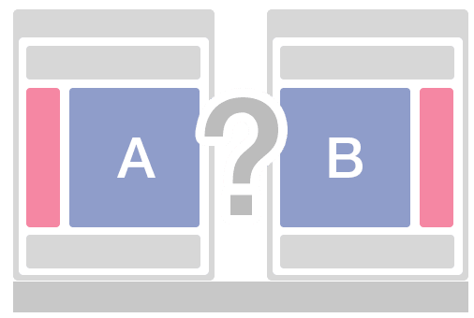
A/B Testing
Jianwei Lai
jlai12@ilstu.edu

Slide 2
Today’s Content
A/B Testing
Online usability testing

Slide 3
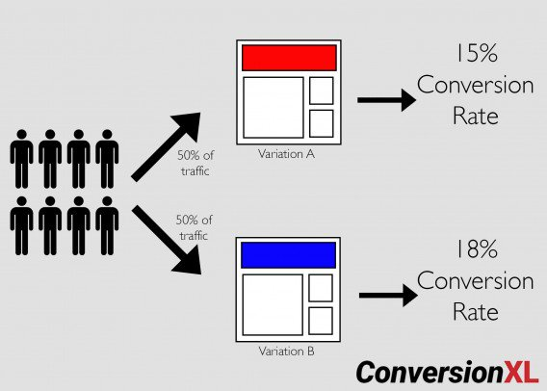
What is A/B Testing?
A/B testing (also known as split testing or bucket testing) is a method of comparing two versions of a webpage or app against each other to determine which one performs better.
https://conversionxl.com/blog/ab-testing-guide/

Slide 4
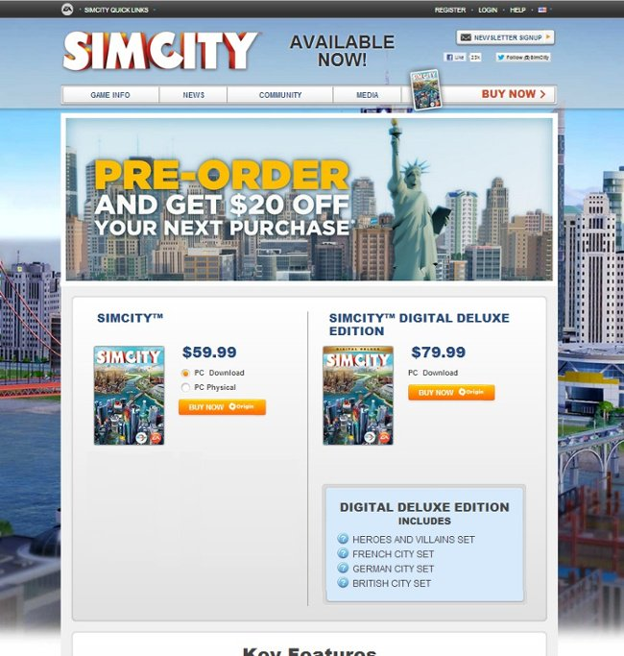
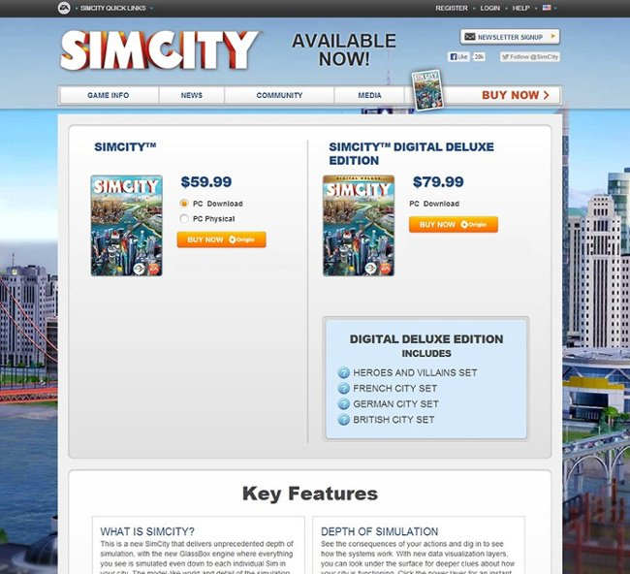
The variation with no offer messaging drove 43.4% more purchases
https://blog.hubspot.com/marketing/a-b-testing-experiments-examples

Slide 5
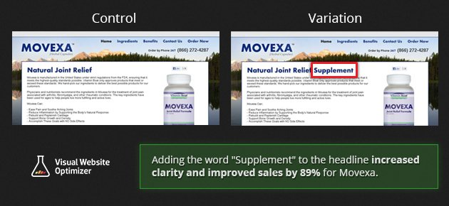
A vitamin and supplement company tweaked their headline to add the word “supplement” and increased conversions by a whopping 89.97%.
https://optinmonster.com/8-ab-tests-to-run-on-your-popups-to-get-more-email-subscribers/

Slide 6
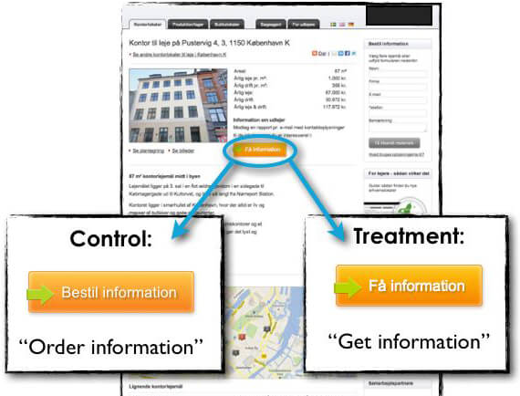
Michael Aagaard tweaked the button copy for a client and saw a 38.26% increase in conversions. The control read “Order information”, and the winning variation read “Get information”.

Slide 7
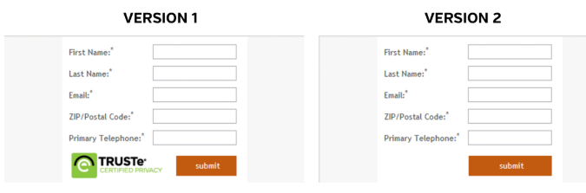
You may be surprised to learn that the victor – by a not-insubstantial 12.6% – was the second version; the version without the TRUSTe security badge.
https://www.targetinternet.com/examples-of-effective-ab-testing-in-action/

Slide 8
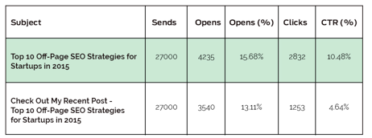
Click-through Rate (CTR)
2.57% increase in Open Rates 5.84% Higher Click-through Rate (CTR) by Changing the Subject Line of an Email
https://www.abtasty.com/blog/learn-from-5-ab-test-case-studies/

Slide 9
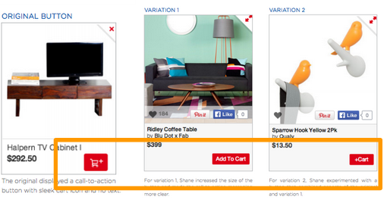
Call-to-Action Button
There was an increase of 49% in CTR over the original after text “Add to Cart” was included in the CTA button rather than just an image or symbol.

Slide 10
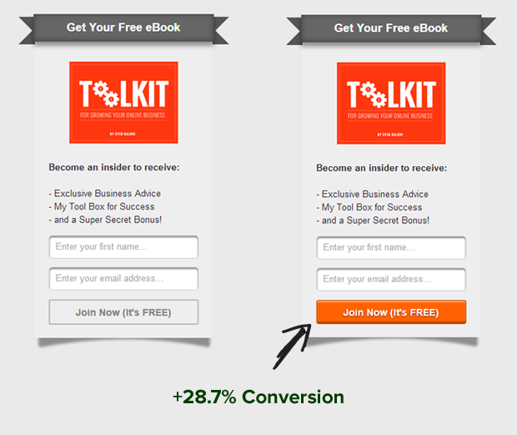

Slide 11
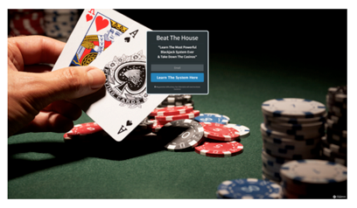
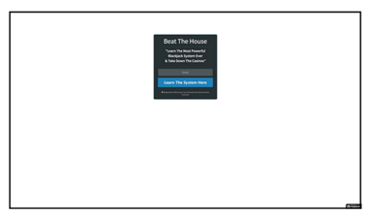
Which one has higher conversion rate?
The conversion rate of the background with a photo was 25.14% as compared to 7.68% for the one without a photo.

Slide 12
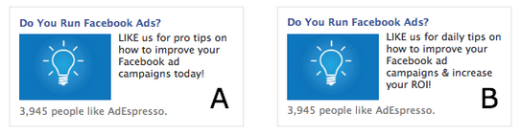
Which one gets for likes?
Version A “LIKE us for pro tips on how to improve your Facebook ad campaigns today!” resulted in 70 Facebook likes. Version B didn’t even get 1 like.

Slide 13
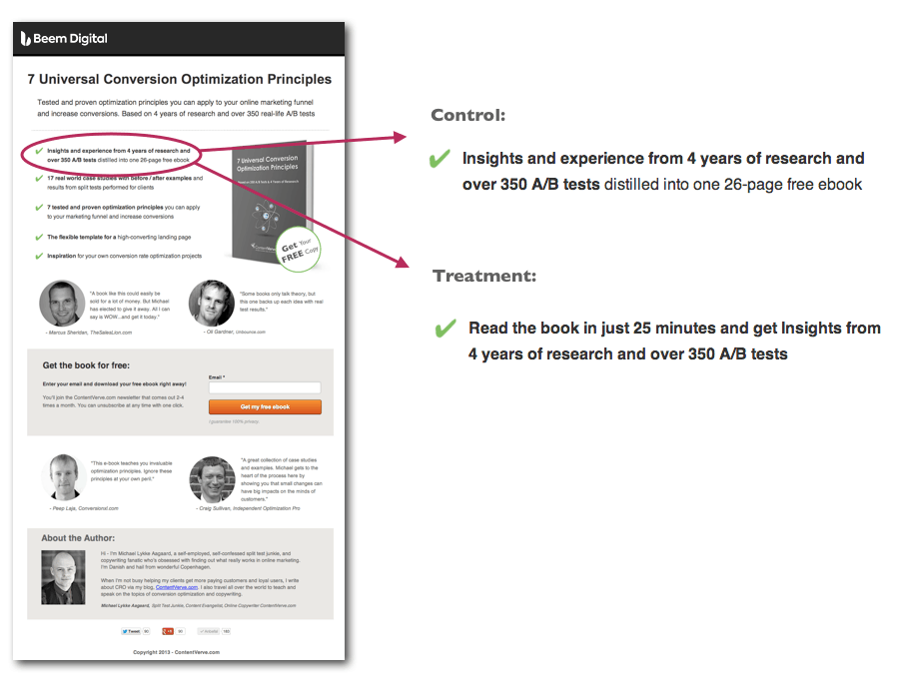

Slide 14
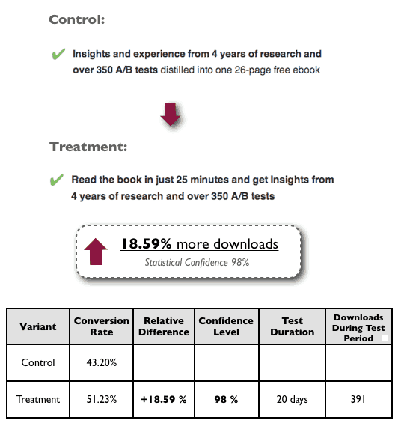
https://beemdigital.com/case-study-increase-in-downloads-tweaking-bullet-point

Slide 15
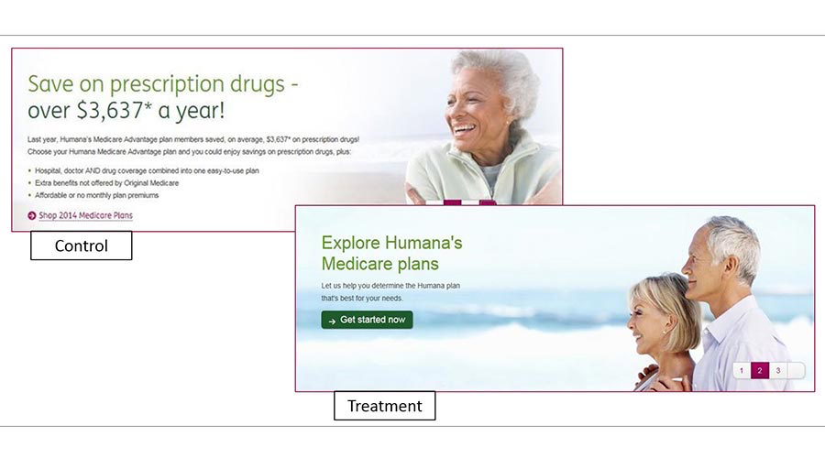
The cleaner variation achieved a staggering 433% increase in clickthroughs.
https://www.designforfounders.com/ab-testing-examples/

Slide 16
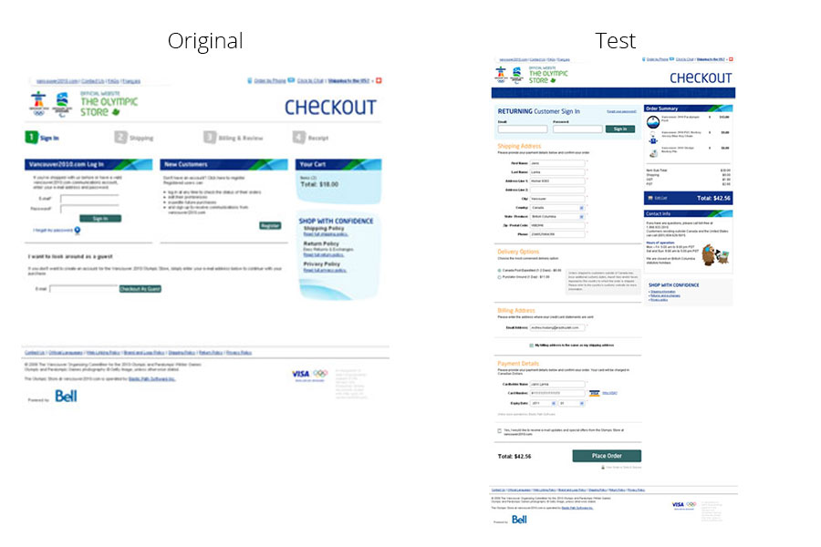
Removing a barrier increased completed purchases by 21.8%.
They let their customers check out without the sign-up, moving the extra step of creating an account to the end of the process, after the check out.

Slide 17
75 general UI ideas
https://goodui.org/

